Slide 1

Online Algorithm for Airport Management Final Presentation
Students: Yoav Cohen, Hodaya Cohen-Adiv
Supervisor: Ayal Taitler
Context: Project A
Semester: Winter, 2020
Date: 15/11/2021

Slide 2
Motivation
An airport has a lot of operations everyday.
Multiple planes that simultaneously take off and land.
Operations that depend on other operations.
Unexpected problems create conflicts and may change the day plan.
Airport management is done with a day plan and executed it in real time.

Slide 3

The problem
Building a day plan and monitoring it in real time is a complex problem.
This problem is divided into two:
The offline algorithm - building a day plan based on daily requirements.
The online algorithm - given an existing program and dealing with unexpected events.

Slide 4
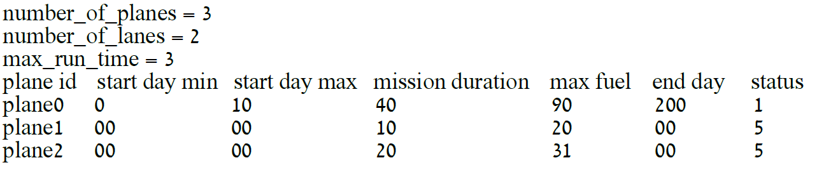
Offline algorithm
Implemented using graph theory and boosted by neural network.
Input – a config file.
Output – day plan as a log file.

Slide 5
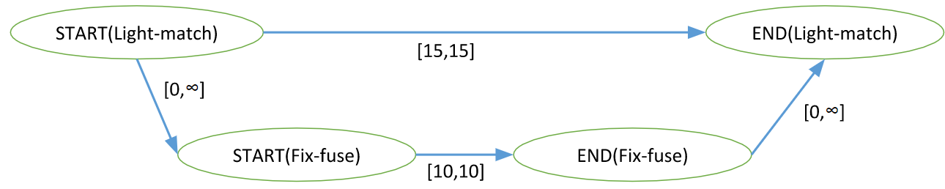
Planning with times and constraints
The planning problem under time constraints is an optimization problem that finds the optimal solution.
The constraints are represented in data structure called STN graph.

Slide 6



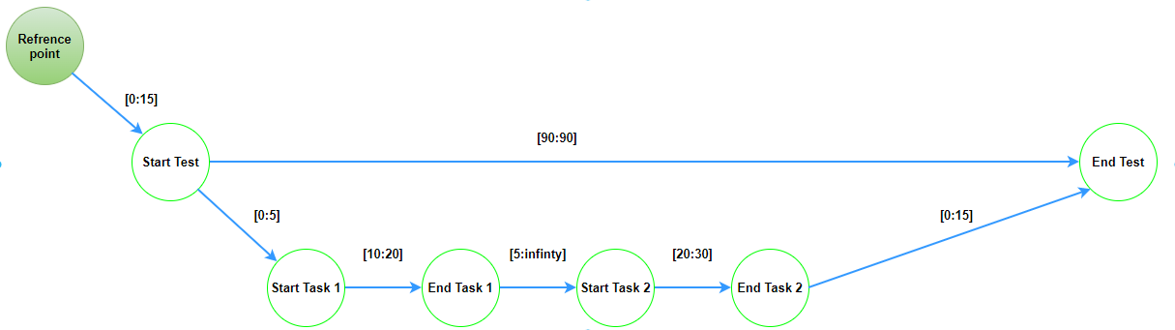
STN graph example with interrupt

Slide 7
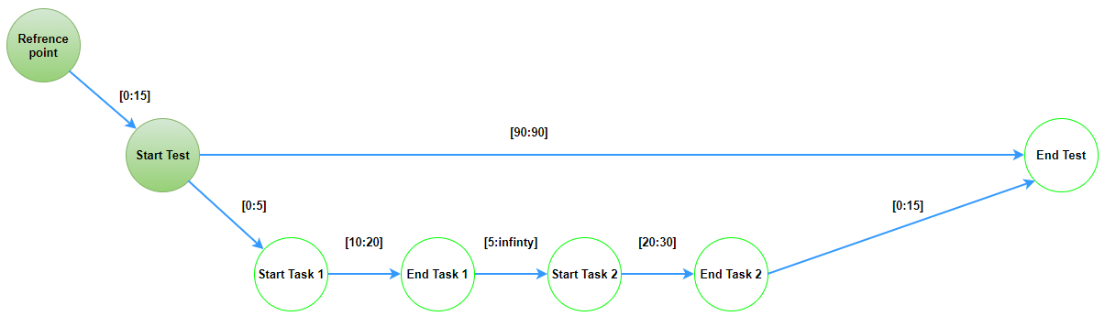
STN graph example with interrupt

Slide 8
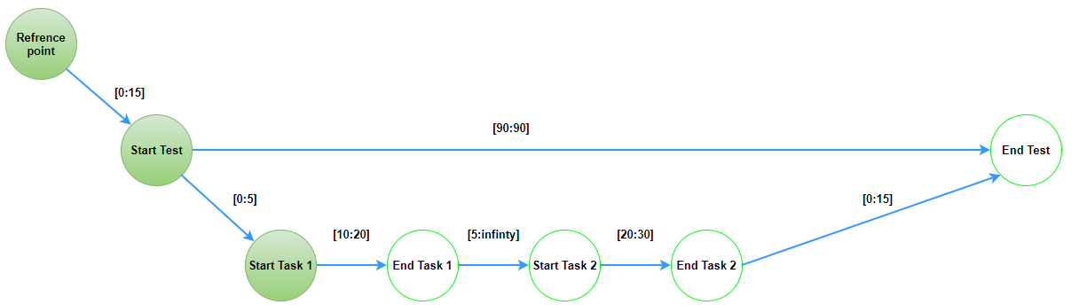
STN graph example with interrupt

Slide 9
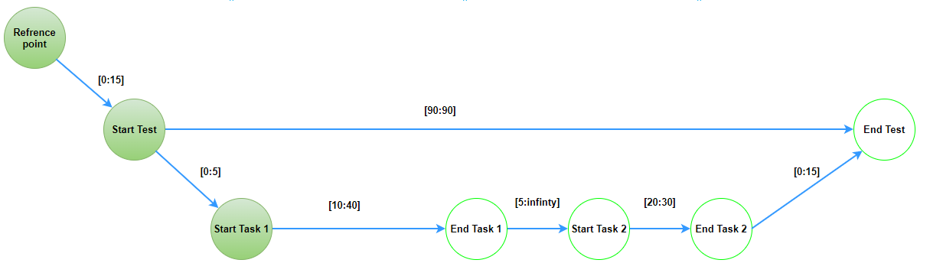
STN graph example with interrupt

Slide 10
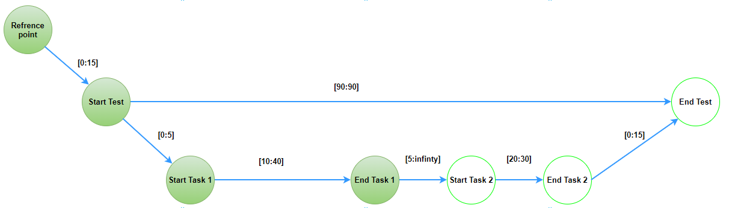
STN graph example with interrupt

Slide 11
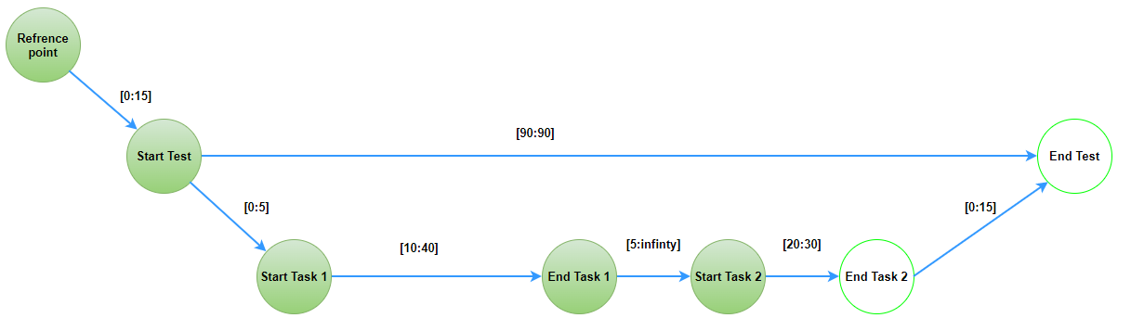
STN graph example with interrupt

Slide 12
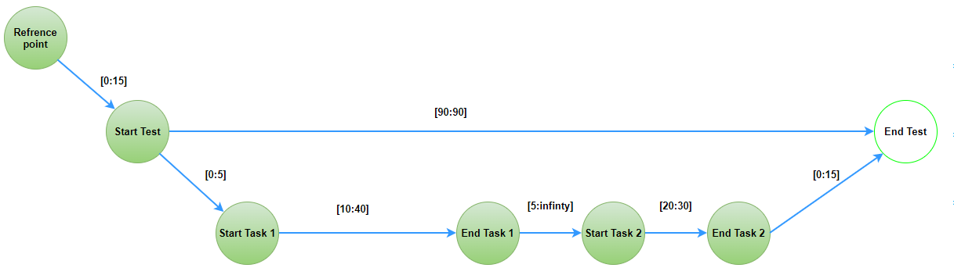
STN graph example with interrupt

Slide 13
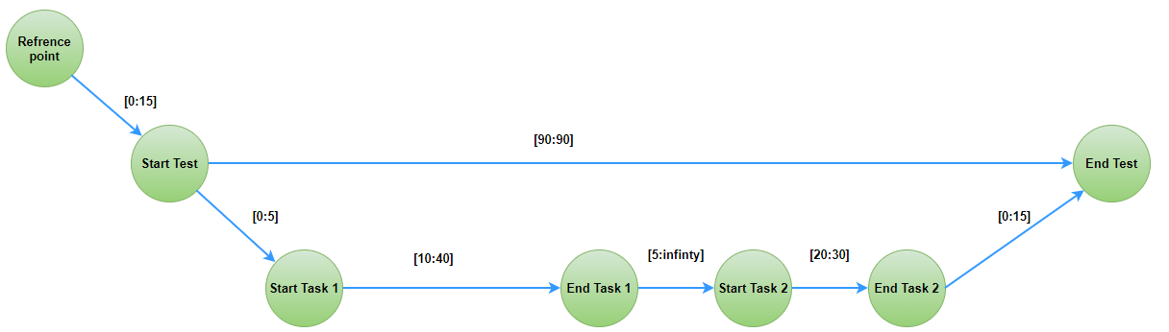
STN graph example with interrupt

Slide 14
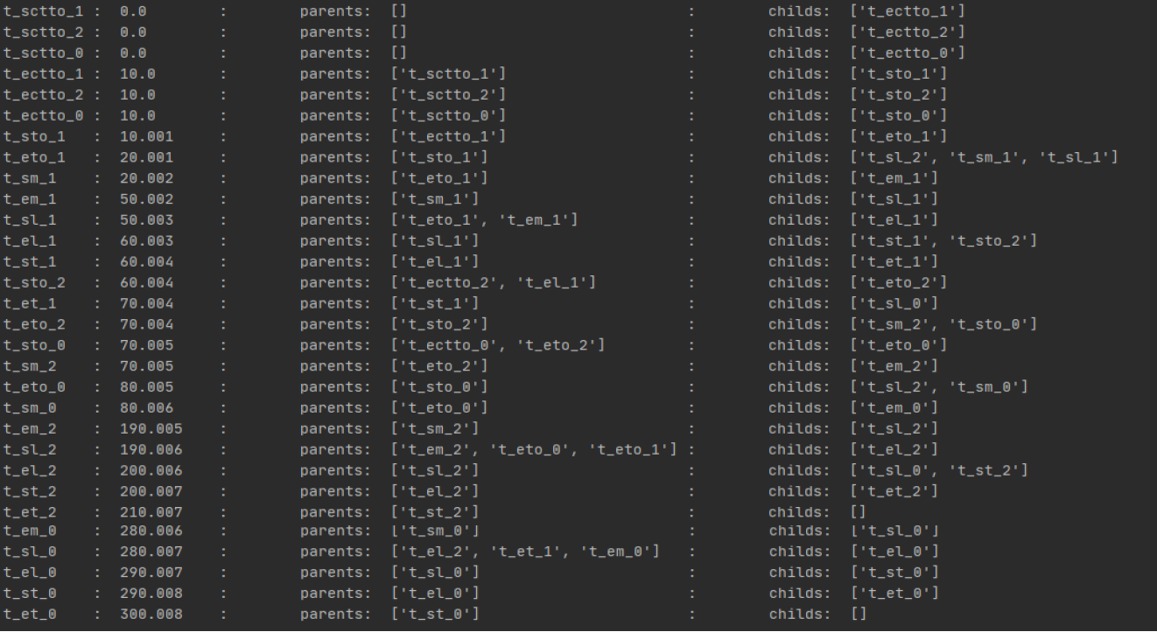
Online algorithm
Implemented with:
Object oriented programing
Design patterns
Algorithm design
Input - a config file and STN graph.
Output - log file as an output.

Slide 15
Project goal
Creating an online algorithm to manage takeoff and landing
Our algorithm ran the offline plan while dealing with real-time malfunctions and changes.
The algorithm must decide whether the program can run with the different constraints or whether replanning is needed.

Slide 16
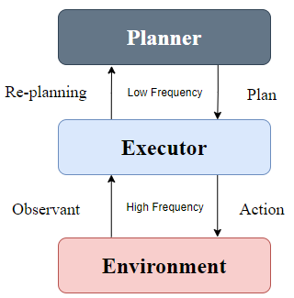
General schema of the problem

Slide 17
Project assumptions
No simultaneous takeoffs and landings.
Replanning time is negligible.
The only interrupt is a delay.

Slide 18
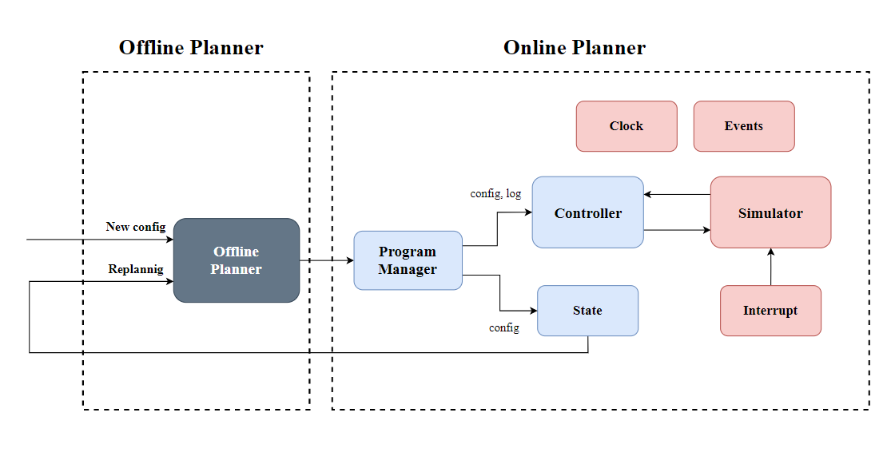
Block diagram

Slide 19
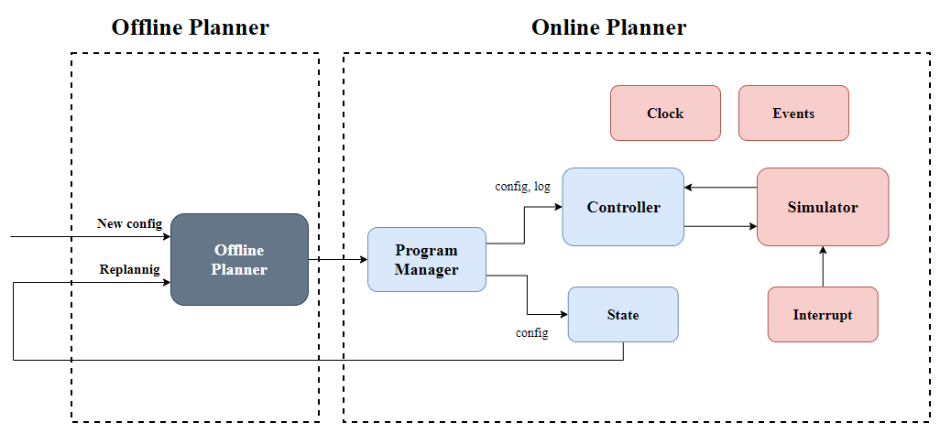
Program manager
Creating global and local modules
Cleaning global modules at the end of each test
Checking if replanning is needed and run the offline planner

Slide 20
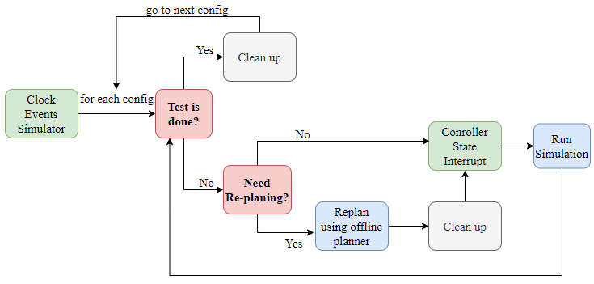
Program manager

Slide 21
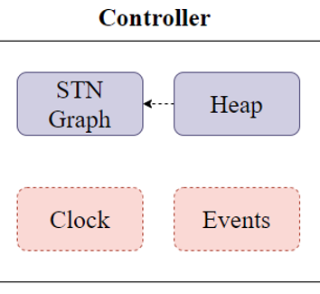
Controller module
Graph, Heap (Priority Queue)
Holds ref to: Clock, Events
Subscriber: Interrupt

Slide 22
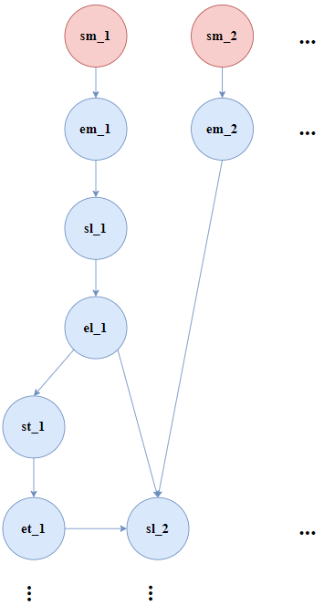
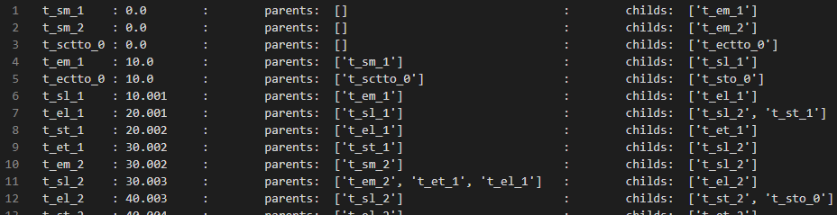
Controller module STN Graph

Slide 23
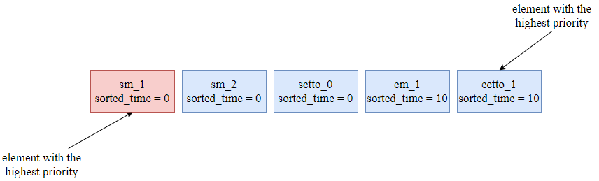
Controller module Heap

Slide 24
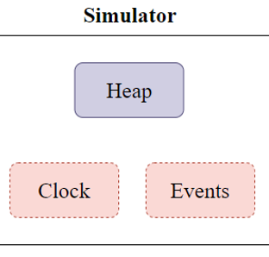
Simulator module
Heap (Priority Queue)
Holds ref to: Clock, Events
Subscriber: State

Slide 25
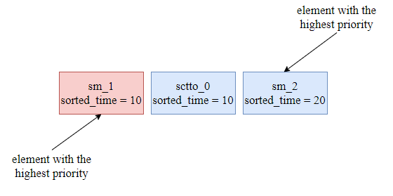
Simulator module
Heap

Slide 26
State module
Plane Vector, Lane Vector
Holds ref to: Clock, Events
Listen to : Simulator
Start state | idle
Start clear to take off | sctto
End clear to take off | ectto
Start take off | sto
End take off | eto
Start mission | sm
End mission | em
Start landing | sl
End landing | el
Start taxi | st
End taxi | et
Final state | done
ectto | sm | sl
Plane 2 | Plane 1 | Plane 0
-1 | 2 | 0
Lane 2 | Lane 1 | Lane 0

Slide 27
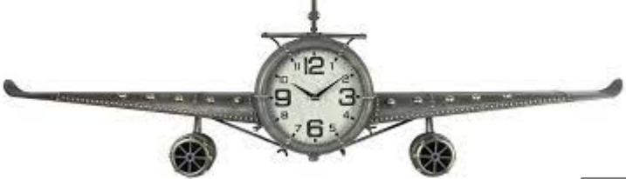
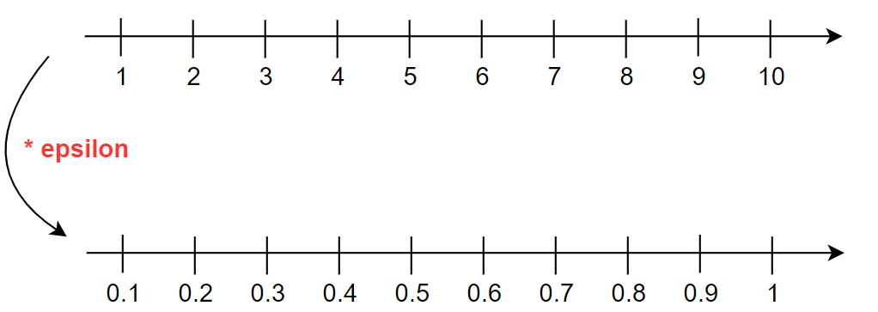
Clock module
Value, epsilon
Holds ref to: Events
Subscriber: Controller, Simulator, State

Slide 28
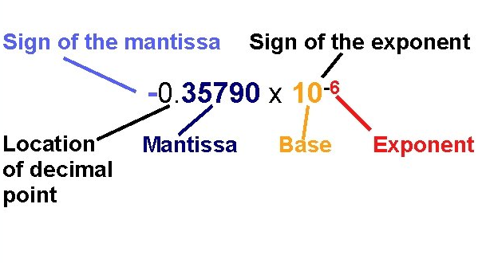
Clock module Problems and Solutions
Representing and comparing to ZERO

Slide 29
Events module
Controller sent action to simulator List | sa
Clock event, no action Boolean | cena
Simulator clock finished action Boolean | cfa
Simulator finished action List | fa
Controller done Boolean | cd
Simulator done Boolean | sd
Random interrupt Number / Boolean | rand
Replanning False: no replanning Number: replanning (version number) | rp
Test done True: test done False: regular test Number: replanning | test
List
Subscriber:
Clock
Controller
Simulator
State
Interrupt

Slide 30

Interrupt module
Action count, duration
Holds ref to: Clock, Events
Listen to : Controller

Slide 31
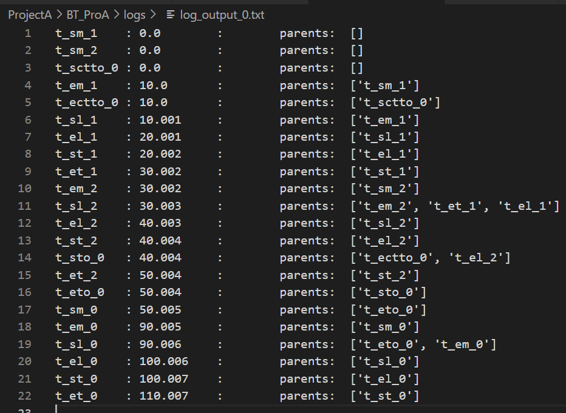
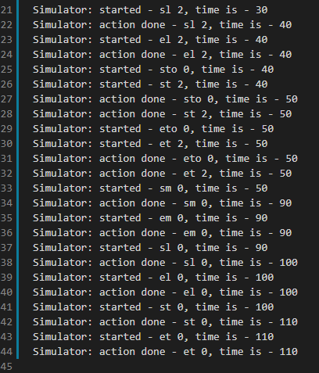
Log output
Offline plan
Run – without interrupts

Slide 32
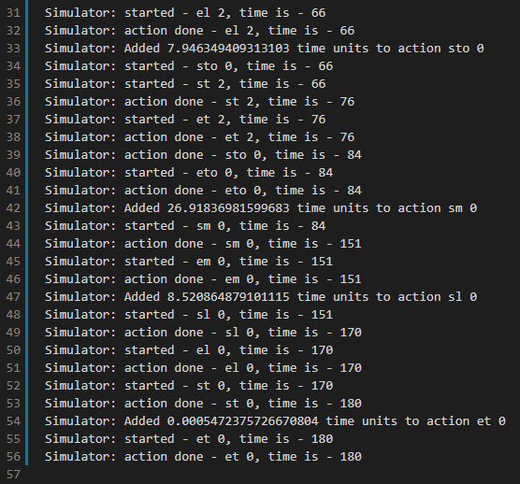
Log output
Offline plan
Run – with interrupts

Slide 33
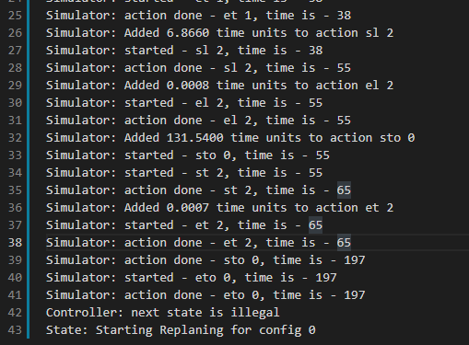
Log output Replanning
Run – without interrupts
Run with replanning – with interrupts

Slide 34
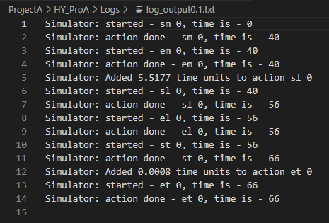
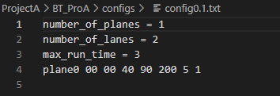
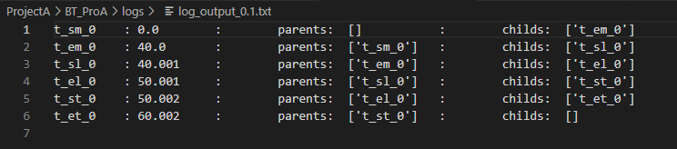
Log output Replanning
New Run after the replanning
New config for the replanning
New STN for the replanning

Slide 35


Future work
More types of interruptions
Add a GUI - make the system interactive

Slide 36

Questions

